Slide 1
Classification: Decision Tree
Swarna Chaudhary
swarna.chaudhary@pilani.bits-pilani.ac.in

Slide 2

The slides presented here are obtained from the authors of the books and from various other contributors. I hereby acknowledge all the contributors for their material and inputs.
I have added and modified a few slides to suit the requirements of the course.

Slide 3
Topics to be covered
Module 5 : Decision Tree
Decision Tree Representation
Entropy and Information Gain for an attribute
ID3 Algorithm for decision tree learning
Alternative measures for selecting attributes
Prefer short hypothesis to longer ones, Occam’s razor
Overfitting in Decision Tree
Reduced Error Pruning and Rule post pruning
Interpretability of Decision Trees

Slide 4
Decision Tree

Slide 5
Decision trees
Decision Trees is one of the most widely used and practical methods of inductive inference
Features
Method for approximating discrete-valued functions
Learned functions are represented as decision trees (or if-then-else rules)
Interpretable Not black box
Humans can understand decisions
Decision tree good at handling noisy or missing system (low information gain)
Fast and Compact
Greedy (disadvantages)
Overfitting avoided by pruning

Slide 6
Decision Tree Induction
Decision tree induction is the learning of decision trees from class-labeled training tuples.
Decision tree is a flowchart-like tree structure,
internal node (denoted by rectangles) denotes a test on an attribute,
each branch represents an outcome of the test, and
each leaf node (or terminal node, denoted by ovals ) holds a class label
Used for classification.
Easily converted to classification rules.
Does not require any domain knowledge.
Decision tree algorithms: ID3(Iterative Dichotomiser), C4.5 (successor of ID3), CART(classification and regression trees).
Adopt greedy approach
Based on top- down recursive divide and conquer approach.

Slide 7
Decision Tree Induction: An Example
Training data set: Buys_computer
Resulting tree:
age?
youth
overcast
Senior
Midle_aged
student?
yes
credit rating?
no
yes
excellent
fair
no
yes
yes
no

Slide 8
Algorithm for Decision Tree Induction
Basic algorithm (a greedy algorithm)
At start, all the training examples are at the root
Attributes are categorical (if continuous-valued, they are discretized in advance)
It uses “Attribute_selection_method” to determine the splitting criteria.
Test attributes are selected on the basis of a heuristic or statistical measure (e.g., information gain)
Conditions for stopping partitioning
All samples for a given node belong to the same class
There are no remaining attributes for further partitioning – majority voting is employed for classifying the leaf
There are no samples left
Complexity is O(n X |D| X log|D|), where n is the number of attributes describing the tuples in D, |D| is the number of training tuples.

Slide 9
Splitting Criteria
Splitting criterion tells us which attribute to test at node N by determining the “best” way to separate or partition the tuples in D into individual classes
Also, tells us which branches to grow from node N with respect to the outcomes of the chosen test.
Splitting criterion indicates the splitting attribute and may also indicate either a split-point or a splitting subset
Partition is “Pure” i.e. all the tuples in it belong to the same class.
Splitting attribute A can be:
A is discrete valued: outcome correspond to the known values of A.
A is continuous-valued: the test at node N has two possible outcomes, corresponding to the conditions A<=split_point and A > split_point, respectively.
A is dicrete-values and Binary tree: The test at node N is of the form “A ∈S_{A}?,” where S_{A} is the splitting subset for A,. If a given tuple has value a_{j} of A and if a_{j} ∈S_{A}, then the test at node N is satisfied.

Slide 10
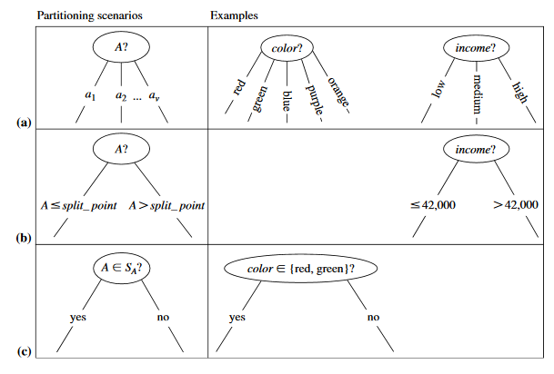
Splitting criteria…contd
a) Discrete-valued b) Continuous-valued c) discrete-valued and binary tree

Slide 11
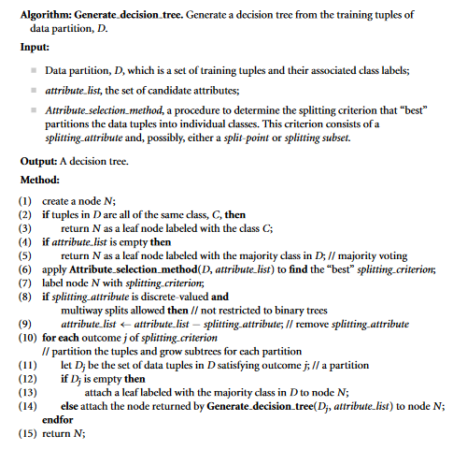
Decision-tree Algorithm

Slide 12
Attribute Selection Measures
Also, known as Splitting rules
Measure is a heuristic for selecting the splitting criterion that “best” separates a given data partition D, of class-labeled training tuples into individual classes.
Partition should be pure (i.e., all the tuples that fall into a given partition would belong to the same class).
Provides ranking to each attribute of training tuple, and the attribute having “best” score is chosen as the splitting attribute.

Slide 13
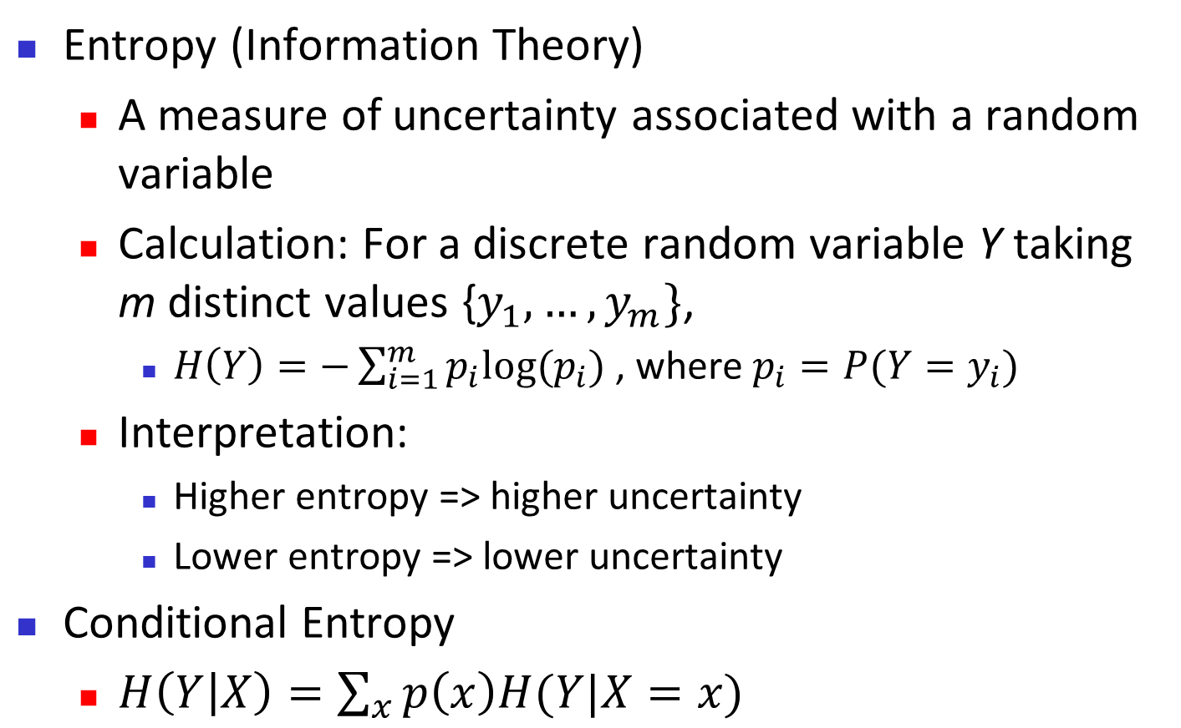
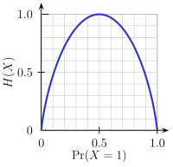
Brief Review of Entropy
m = 2

Slide 14
Attribute Selection Measure: Information Gain (ID3/C4.5)
Select the attribute with the highest information gain
This attribute minimizes the expected number of tests needed to classify a given tuple.
Let p_{i} be the probability that a tuple in D belongs to class C_{i}, estimated by |C_{i, D}|/|D|, m is the number of distinct classes, v is the number of distinct values in an attribute.
Expected information (entropy) needed to classify a tuple in D:
Information needed (after using A to split D into v partitions) to classify D
The smaller the expected information required, greater the purity of the partitions.

Slide 15
Attribute Selection Measure: Information Gain (ID3/C4.5)
Information gained by branching on attribute A
Defined as the difference between the original information requirement (i.e. based on just the proportion of the classes) and the new requirement (i.e. obtained after partitioning of attribute A).
Attribute with highest information gain Gain(A), is chosen as the splitting attribute at node N.
Notes:
I : the expected information needed to classify a given sample
E (entropy) : expected information based on the partitioning into subsets by A

Slide 16
Attribute Selection: Information Gain
Class P: buys_computer = “yes”
Class N: buys_computer = “no”
means “age <=30” has 5 out of 14 samples, with 2 yes’es and 3 no’s.
Similarly,

Slide 17
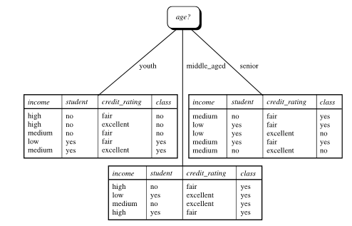
Attribute Selection: Information Gain

Slide 18
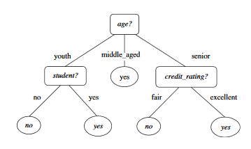
Decision Tree
Decision tree for the concept “buys_computer”

Slide 19
Splitting Based on Continuous Attributes
Different ways of handling
Discretization to form an ordinal categorical attribute
Binary Decision: (A < v) or (A ≥ v)
consider all possible splits and finds the best cut
can be more compute intensive

Slide 20
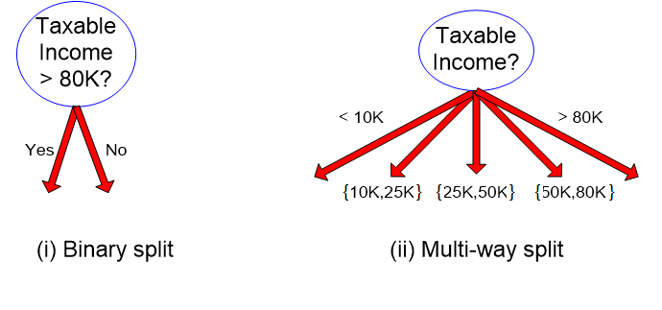
Splitting Based on Continuous Attributes

Slide 21
Computing Information-Gain for Continuous-Valued Attributes
Let attribute A be a continuous-valued attribute
Must determine the best split point for A
Sort the value A in increasing order
Typically, the midpoint between each pair of adjacent values is considered as a possible split point
(a_{i}+a_{i+1})/2 is the midpoint between the values of a_{i} and a_{i+1}
The point with the minimum expected information requirement for A is selected as the split-point for A
Split:
D1 is the set of tuples in D satisfying A ≤ split-point, and D2 is the set of tuples in D satisfying A > split-point

Slide 22
Question?
Compute the information gain for every possible split, for the given continuous valued attribute?
Sort the values and find the the midpoint between each
pair of adjacent values (split_point).
Calculate Info(D)
Calculate the entropy for each split_point for “<=” and “>”
Find Gain for each split_point
A1 | A2 | Class
T | 1 | +
T | 6 | +
T | 5 | -
F | 4 | +
F | 7 | -
F | 3 | -
F | 8 | -
T | 7 | +
F | 5 | -
Class | + | - | + | - | + | - | -
Sorted A2 | 1 | 3 | 4 | 5 | 6 | 7 | 8
Split_Point |  | 2 | 3.5 | 4.5 | 5.5 | 6.5 | 7.5

Slide 23
Gain Ratio for Attribute Selection (C4.5)
Information gain measure is biased towards attributes with a large number of distinct values. Eg. Product_ID (unique for every tuple), resulting in large number of partitions as Info_{product_ID} (D) = 0, Such partitioning is useless.
C4.5 (a successor of ID3) uses gain ratio to overcome the problem.
It applies normalization to information gain using a “split information”
GainRatio(A) = Gain(A)/SplitInfo_{A} (D)
Ex. Gain Ratio of “income” on the given data set.
gain_ratio(income) = 0.029/1.557 = 0.019
The attribute with the maximum gain ratio is selected as the splitting attribute

Slide 24
Gini Index (CART, IBM IntelligentMiner)
If a data set D contains examples from n classes, gini index, gini(D) is defined as
where p_{j} is the probability that a tuple in D belongs to class j is |C_{j,D} |/|D|
It considers binary-split for each attribute
If a data set D is split on A (such that A∈ S_{A}?) into two subsets D₁ and D₂, the gini index gini(D) is defined as
Reduction in Impurity:
The attribute provides the minimum gini_{split}(D) (or the largest reduction in impurity) is chosen to split the node (need to enumerate all the possible splitting points for each attribute)

Slide 25
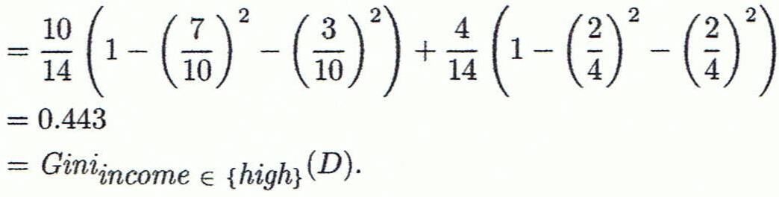
Computation of Gini Index
Ex. D has 9 tuples in buys_computer = “yes” and 5 in “no”
Suppose the attribute income partitions D into 10 in D₁: {low, medium} and 4 in D₂
Gini_{{low,high}} is 0.458; Gini_{{medium,high}} is 0.450. Thus, split
on the {low,medium} (and {high}) since it has the lowest
Gini index
May need other tools, e.g., clustering, to get the possible
split values

Slide 26
Comparing Attribute Selection Measures
The three measures, in general, return good results but
Information gain:
biased towards multivalued attributes
Gain ratio:
tends to prefer unbalanced splits in which one partition is much smaller than the others
Gini index:
biased to multivalued attributes
has difficulty when # of classes is large

Slide 27
Decision Tree Based Classification
Advantages:
Inexpensive to construct
Extremely fast at classifying unknown records
Easy to interpret for small-sized trees
Accuracy is comparable to other classification techniques for many simple data sets

Slide 28
Inductive bias in decision tree learning
Inductive bias is the assumptions made by the model to learn the target function and to generalize beyond training data.
What is the inductive bias of DT learning?
Shorter trees are preferred over longer trees
This is the bias exhibited by a simple breadth first algorithm generating all DT's e selecting the shorter one
Prefer trees that place high information gain attributes close to the root

Slide 29
Prefer shorter hypotheses: Occam's razor
Why prefer shorter hypotheses?
Arguments in favor:
There are fewer short hypotheses than long ones
If a short hypothesis fits data unlikely to be a coincidence
Elegance and aesthetics
Arguments against:
Not every short hypothesis is a reasonable one.
Occam's razor says that when presented with competing hypotheses that make the same predictions, one should select the solution which is simple"

Slide 30
Issues in decision trees learning
Overfitting
Building trees that “adapt too much” to the training examples may lead to “overfitting”.
May therefore fail to fit additional data or predict future observations reliably
Notes:
L'overfitting può succedere quando c' è rumore nei dati.

Slide 31
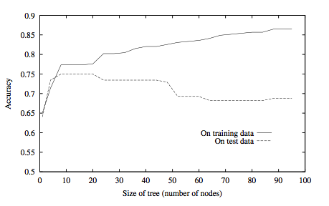
Overfitting in decision tree learning
Notes:
ID3 is used to learn which medical patients have a form of diabetes.
Horizontal axis reports number of nodes in the tree
Vertical axis the accuracy of the prediction
The accuracy on the training keeps growing while accuracy on the test data grows up to trees with 25 node then starts decreasing.

Slide 32
How to Address Overfitting
Pre-Pruning (Early Stopping Rule)
Stop the algorithm before it becomes a fully-grown tree
General stopping conditions for a node:
Stop if all instances belong to the same class
Stop if all the attribute values are the same
More restrictive conditions (for pre-pruning) :
Stop if number of instances is less than some user-specified threshold
Stop if class distribution of instances are independent of the available features (e.g., using χ ² test)
Stop if expanding the current node does not improve impurity measures (e.g., Gini or information gain).

Slide 33
How to Address Overfitting…
Post-pruning
Grow decision tree to its entirety
Trim the nodes of the decision tree in a bottom-up fashion
If generalization error(i.e. expected error of the model on previously unseen records) improves after trimming, replace sub-tree by a leaf node.
Class label of leaf node is determined from majority class of instances in the sub-tree

Slide 34
Good References
Decision Tree
https://www.youtube.com/watch?v=eKD5gxPPeY0&list=PLBv09BD7ez_4temBw7vLA19p3tdQH6FYO&index=1
Overfitting
https://www.youtube.com/watch?time_continue=1&v=t56Nid85Thg
https://www.youtube.com/watch?v=y6SpA2Wuyt8
Decision tree for regression
https://www.saedsayad.com/decision_tree_reg.htm

Slide 35
Textbook/Reference Books
Tom M. Mitchell: Machine Learning, The McGraw-Hill Companies, Inc..
Tan P. N., Steinbach M & Kumar V. “Introduction to Data Mining” Pearson Education
Data Mining: Concepts and Techniques, Third Edition by Jiawei Han, Micheline Kamber and Jian Pei Morgan Kaufmann Publishers

Slide 36
Thank You
24 July 2021

